Slide 1

Stage 4
Press F To Hose Respects
Course Designer: Eric Beerbaum
Press F To Hose Respects is a 38 round course. There are 19 IDPA targets. The best two hits per target will score. The start signal is audible.
The Handgun start position is standing with one hand touching tree and the other hand holding F above shoulders. Handgun loaded and holstered.
The PCC start position is muzzle touching tree with strong hand holding F above shoulders. PCC loaded, stock on belt, safety on.
On the audible start signal, engage targets from within the shooting area.
Notes:
‹#›

Slide 2
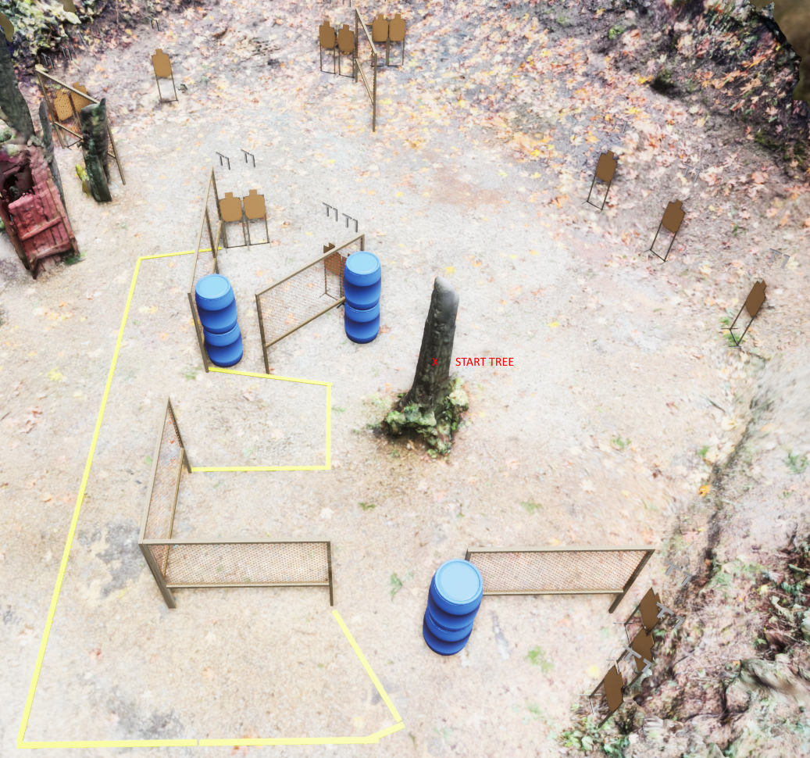
Stage 4
Press F To Hose Respects
Course Designer: Eric Beerbaum

